Slide 1
Robotic Surgery
Yvette Apatiga, Kristen Brown, Jonathan Cantera, Shraddha Swaroop

Slide 2
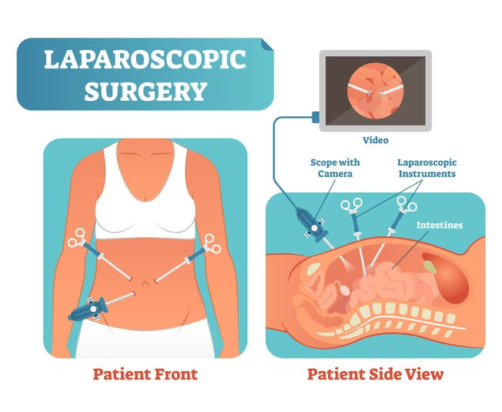
Introduction
Minimally Invasive Surgery (MIS)
A type of surgery approach performed to reduce recovery time through the use of small incisions
Operate by inserting a laparoscope equipped with a camera, light source and surgical instruments
Poor visual feedback and limited mobility

Slide 3
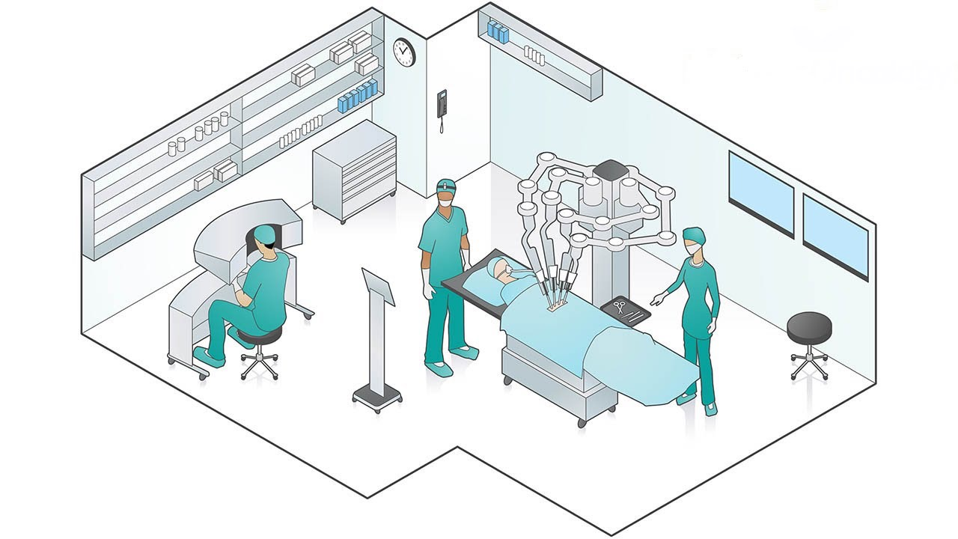
Introduction
Robotic Assisted Surgery (RAS)
Created to mitigate the limitations of MIS and provide
Improved visual acuity
Enhanced mobility
The da Vinci Surgical System (dVSS) was the first RAS approved by the U.S. Food and Drug Administration for MIS in 2000

Slide 4
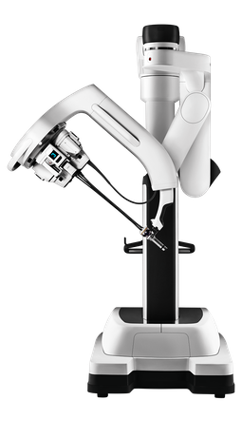
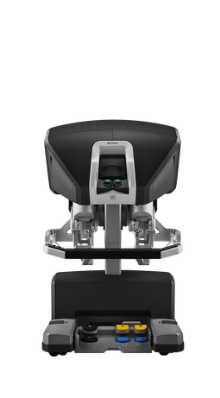
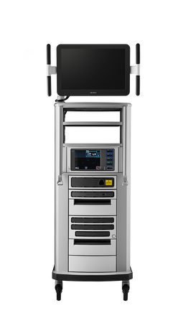
dVSS
Patient cart
Surgeon console
Vision console

Slide 5
Theories: Usability
A theoretical framework that relates to extent in which a system can be used by its intended user
Usability evaluates the achievement of goals within certain contexts with:
Effectiveness
Efficiency
Satisfaction

Slide 6
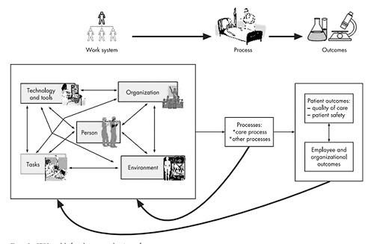
Theories: Systems Engineering Initiative For Patient Safety (SEIPS) Model

Slide 7
Key Issues: Cognitive Workload
Limited capacity for cognitive resources
High workload can increase risk for errors (Yuliya, Scerbo, Prabhu, Acker, & Stefanidis, 2010)
RAS systems should aid surgeons to reduce mental demand (Moore, Wilson, McGrath, Waine, Masters, & Vine, 2014)
Consideration of surgeon attributes (Hu, Lu, Tam, & Lomanto, 2016)

Slide 8
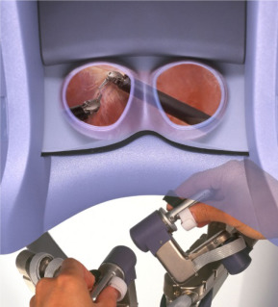
Practical Applications: Cognitive Workload
Provides surgeons with high-definition 3D imaging for a better view of the patient’s anatomy compared to traditional laparoscopic monitor displays. (Foo et al., 2013)
Immersive environment prevents distraction (Sung & Gill, 2006)
Intuitive movements and enhanced dexterity aids in laparoscopic tasks (Sung & Gill, 2006)

Slide 9
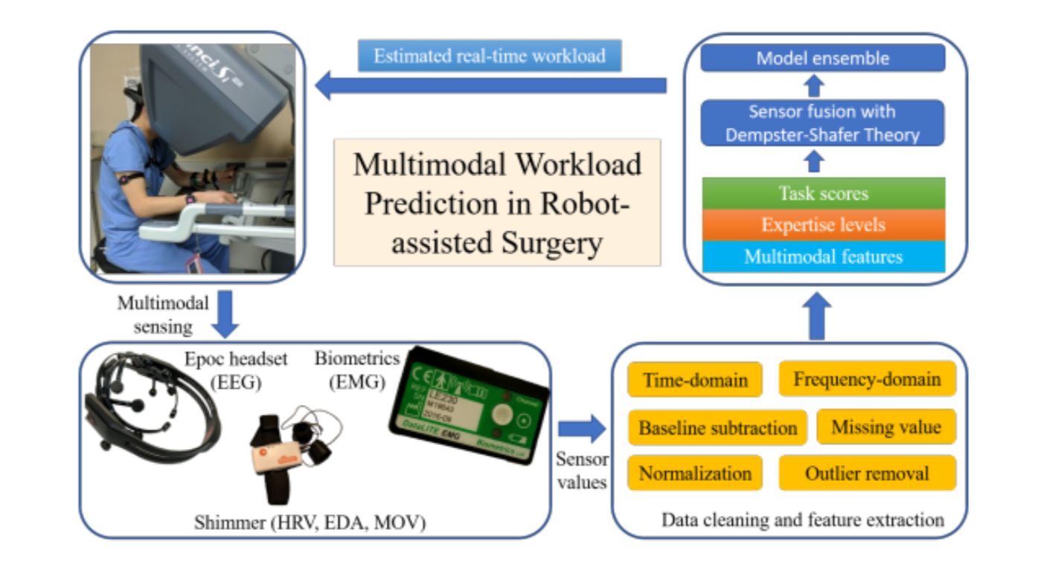
Current Issues: Cognitive Workload
Increased complexity can negatively influence users with less experience in robotic laparoscopic surgery (Zhou, Cha, Gonzalez, Sundaram, Wachs, & Yu, 2019)
Expertise aids cognitive workload (Zheng, Cassera, Martinec, Spaun, & Swanström, 2009)
Consideration of individual differences in surgeon attributes
Design recommendation
Adaptive interface (Zhou, Cha, Gonzalez, Wachs, Sundaram, & Yu, 2018)
Autonomous robotics in its infancy, but has the potential to enhance human-robot collaboration
Figure from Zhou et al., 2019

Slide 10
Key Issues: Ergonomics
MIS tools and monitor displays
Uncomfortable posture
Musculoskeletal concerns
RAS far surpasses ergonomic demands
Continued concern pertaining to neck strain

Slide 11
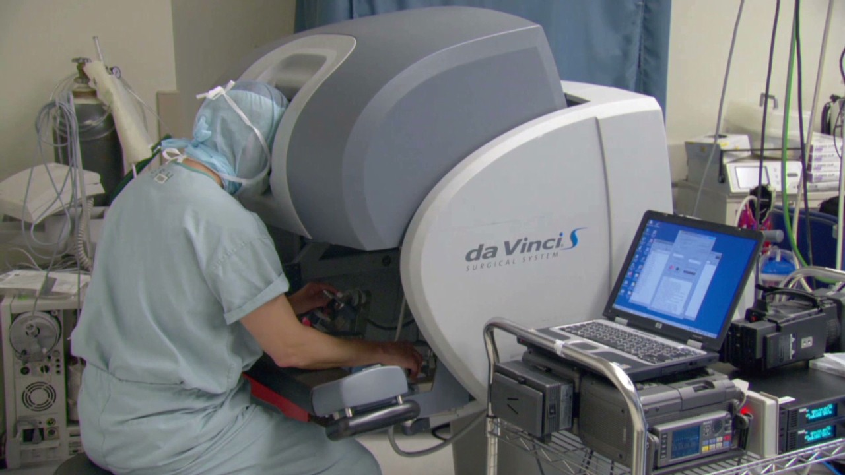
Practical Applications: Ergonomics
dVSS provides surgeons well designed ergonomics:
Adjustable forehead rest
Armrest
Update incluses saving specific surgeons ergonomic preferences
Adjustable interface display

Slide 12
Current Issues: Ergonomics
Closed console
Leaning
Neck strain
Spine curvature; elbow strain
Recommendations:
3D-HD mounted adjustable display
3D glasses for immersion
Reduce neck and muscle strain

Slide 13
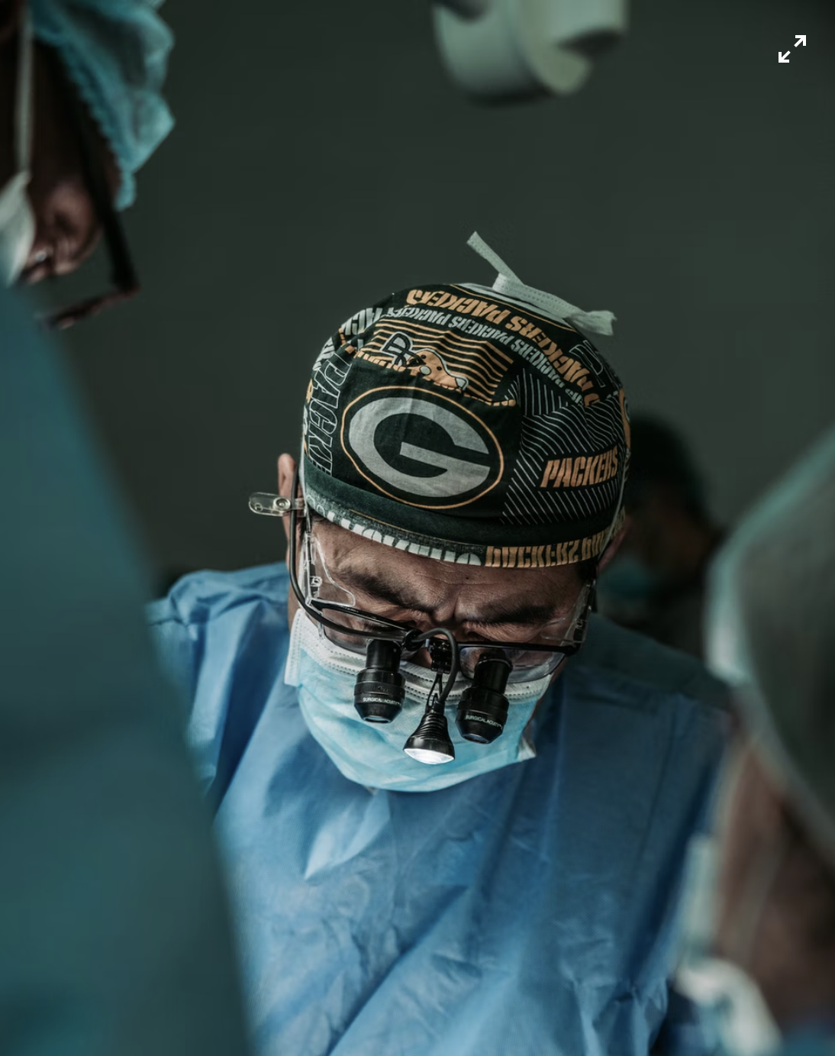
Key Issues: Situation awareness
Situation awareness (SA) is defined as an operator’s perception and understanding of how to do a task influenced by dynamic environmental information for current and future states (Endsley, 1995)
Surgeons with lower SA are prone to make errors if they are unable to perceive and adequately assess the current state of the operation
Team SA is another crucial component in the operating room that can influence performance outcomes (Stanton, Salmon, Walker, Salas, & Hancock, 2017)
Photo by J.C. Gellidon
Notes:
Endsley (1995) defined SA as an operator’s perception and understanding of dynamic environmental information during a task. According to Endsley’s (1995) three-level model, the perception of environmental factors during a certain spectrum of time and space influences an operator’s understanding of their meaning, which then allows them to make the proper decision in the present and future. This complex internal interaction is greatly influenced by attention, knowledge, and working memory, all of which can limit an operator’s ability to obtain and interpret information from their environment
Our findings showed that surgeons with lower SA are prone to make error since they are unable to perceive, understand and make decisions on the current state of the surgery
Also Team SA is another crucial piece of the puzzle in successful surgical comes. This influences performance as the surgeon must know what all members of the team inside the operating team are saying and doing. The team includes both humans and the robotic counterpart.

Slide 14
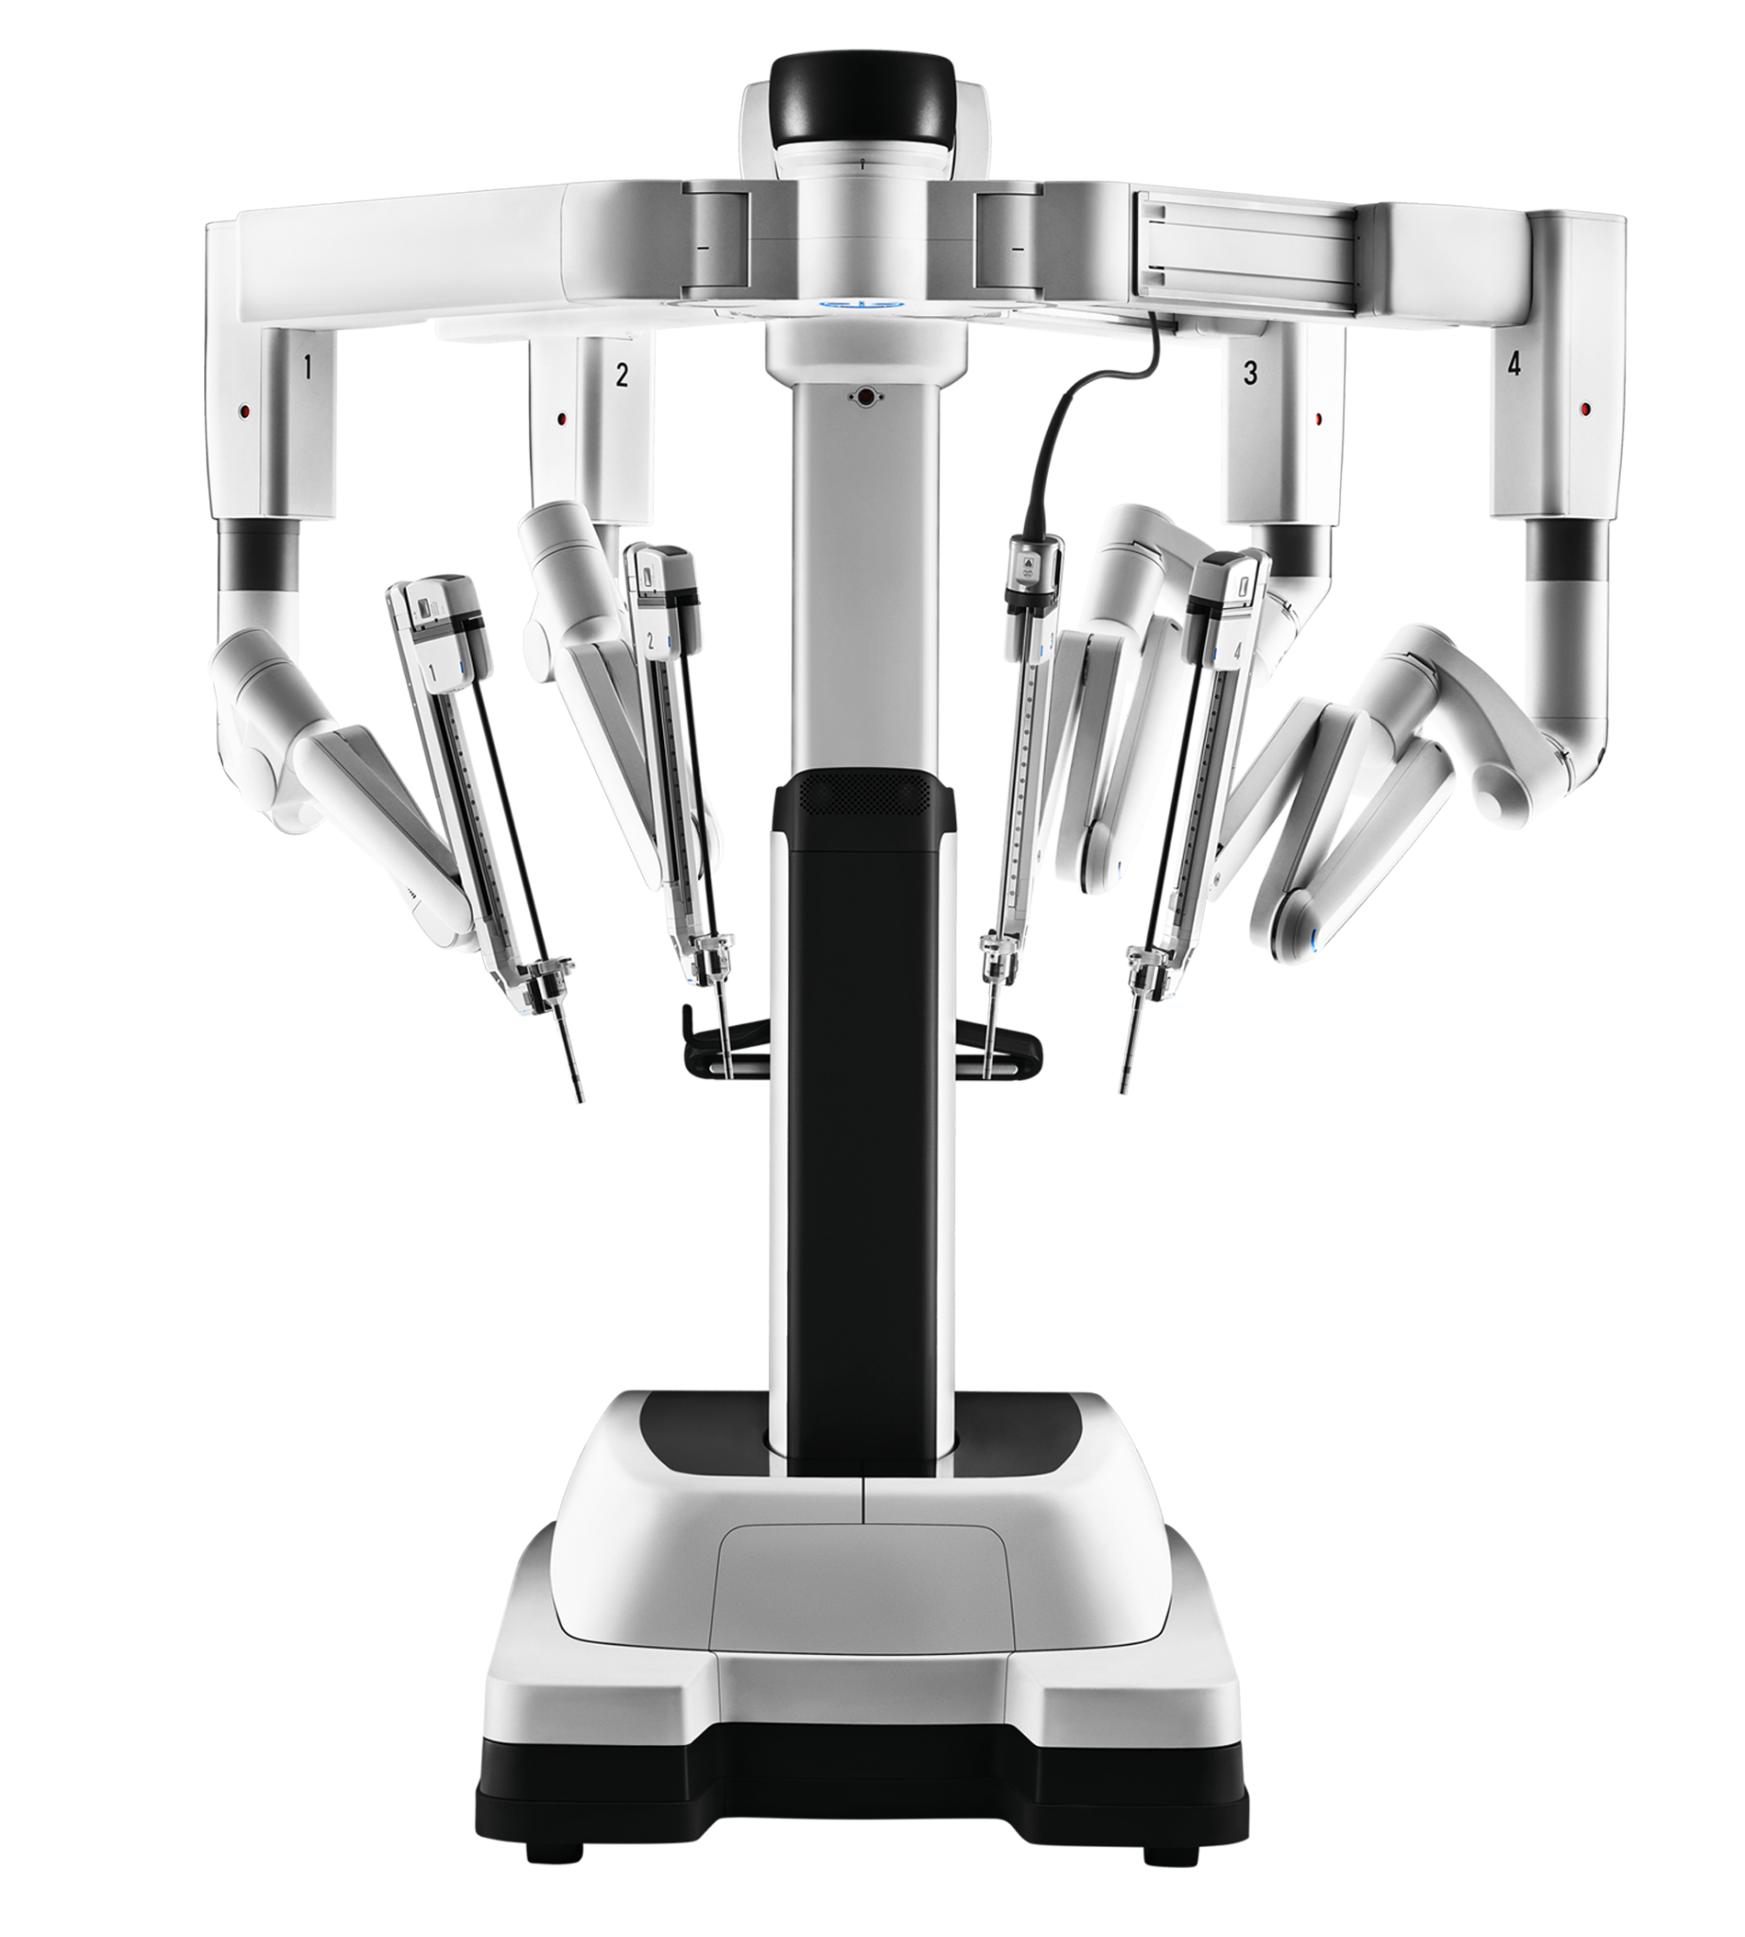
Practical Applications: Situation awareness
The dVSS is the front-runner of robotic surgery systems worldwide and include three multi-jointed wristed instruments, high definition 3-D camera that allows the surgeon to fully focus on target anatomy, eye tracking that zooms in on area surgeon is immersed in.
These tools allow the surgeon to have full internal and external control of the tools used by the robot which assists the surgeon’s SA by increasing visual acuity on the body area focused on
Notes:
The dVSS is the front-runner of robotic surgery systems worldwide and include three multi-jointed wristed instruments, high definition 3-D camera that allows the surgeon to fully focus on target anatomy, eye tracking that zooms in on area surgeon is immersed in.
These tools allow the surgeon to have full internal and external control of the tools used by the robot which assists the surgeon’s SA by increasing visual acuity on the body area focused on

Slide 15
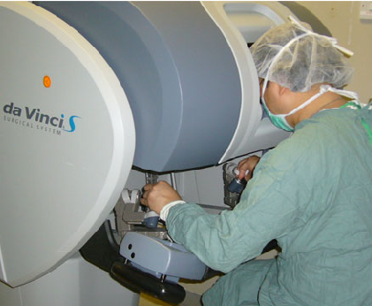
Current Issues: Situation Awareness
Limitation: The current design forces surgeons to keep their heads down within a closed console. The closed console compromises SA because both the surgeon’s vision and communication with the rest of the OR team becomes restricted (Chang et al., 2018).
Recommendation: Surgical teams using dVss should be required to implement readback during surgical operations
Figure from Szeto et al., 2012
Notes:
The current design forces surgeons to keep their heads down within the closed console, compromising SA since the surgeon cannot see or effectively communicate with the rest of the operating room team. Without sufficient SA, tasks can become more challenging as operator and system status transparency is reduced (Chang et al., 2018).
Communication between the surgeon operating the dVSS and the surgical assistant is vital during surgery. Transparency of RAS systems status is paramount for optimal SA. One way to make sure of that is a method called readback. Readback is when team members repeat instructions back in a precise, clear, and standardized manner (Payne & Pitter, 2011). Research has shown that readback is highly beneficial to surgical teams as it increases SA thereby reducing the risk of misunderstanding system requirements (Higuchi & Gettman, 2011). Surgeons immersed in a closed console where they cannot draw on visual cues benefit greatly from readback as it provides the surgeon with ample transparency of system status and team status, thereby increasing SA (Payne & Pitter, 2011). As a result, implementing readback during surgical operations can benefit surgical teams that rely on the dVSS.

Slide 16
Application to Other Systems
Anesthesia Machines
Duties of the Anesthesiologist
Provide continual medical assessment of patient
Monitor and control patient vital life functions
Control the patient’s pain and level of consciousness
Now with RAS - monitor RAS on patient and workaround it
Implement Artificial Intelligence to aid Anesthesiologist with:
Monitor and control anesthesia
Produce event and risk predictions
Aid in overall decision making

Slide 17
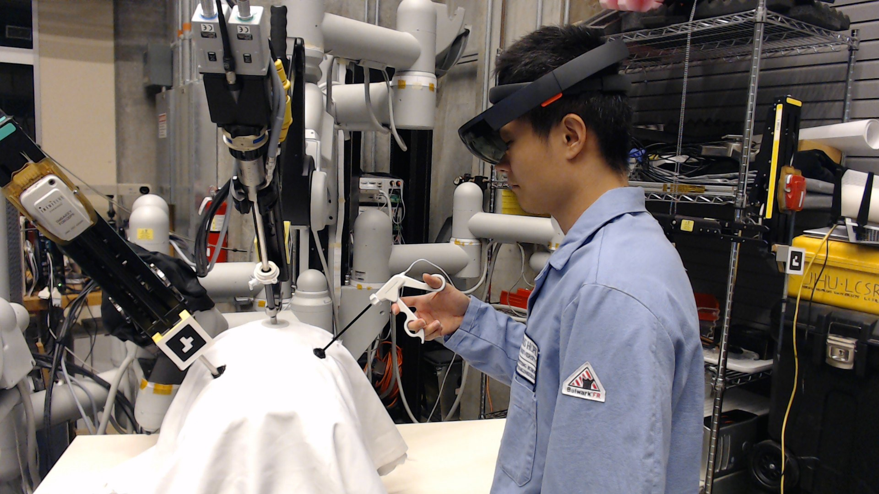
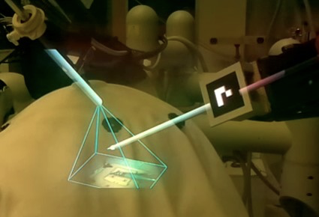
Application to Other Systems
First Assistant Aid
Duties of First Assistant:
Robot docking
Passing necessary materials
Manipulate handheld instruments
Aid with trocar planning and placement
Implement optical see-through head-mounted display (OST-HMD)
Head mounted display
Virtual Stereo Monitor
Endoscope Frustum

Slide 18
Thank You!
Questions?

Slide 19
References
Available upon request
Contact: shraddhaswaroop@gmail.com

